Slide 1

Intelligent vehicle-machine interaction system
Bofang Jia Shuai Li Xiangkai Yin Xingyu Cao

Slide 2
Involved direction and apperception
Introduction to automation and professional orientation
Microcomputer principle and interface technology
Circuit fundamentals
Electronic course design
Programming and systems
Basic Analog Electronics
Sensors and detection technology
Embedded system
Course design of power electronics technology
electron
Computer control system
Basic Digital Electronics
electron
Higher mathematics

Slide 3



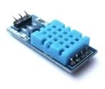

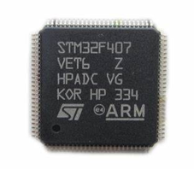
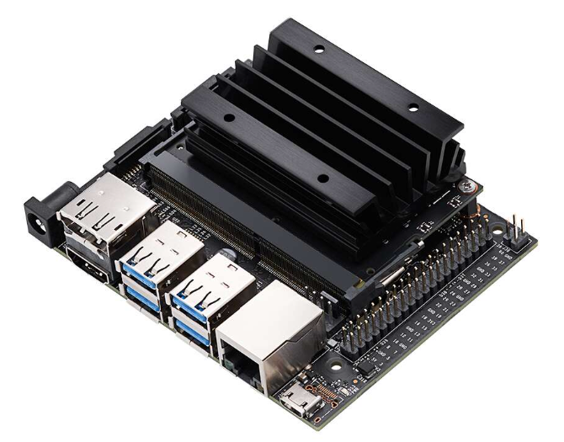
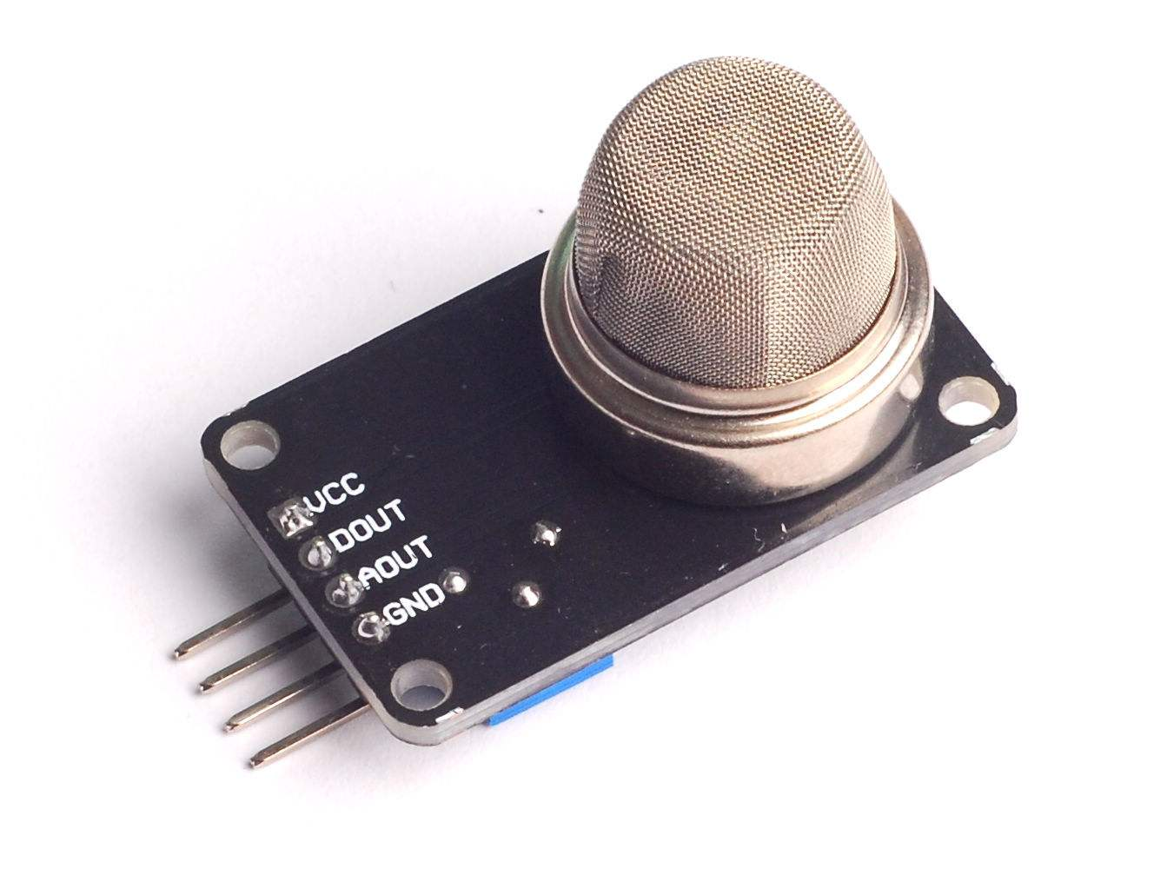

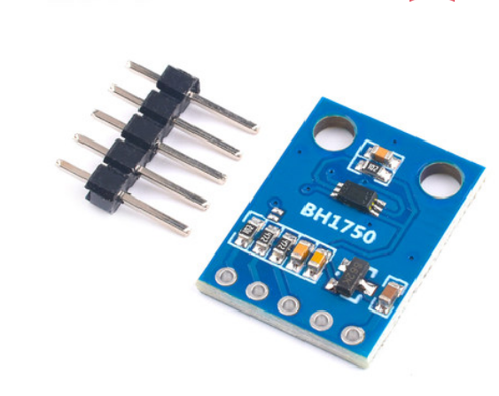
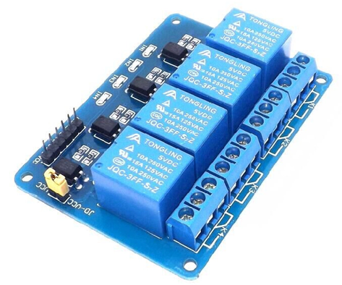
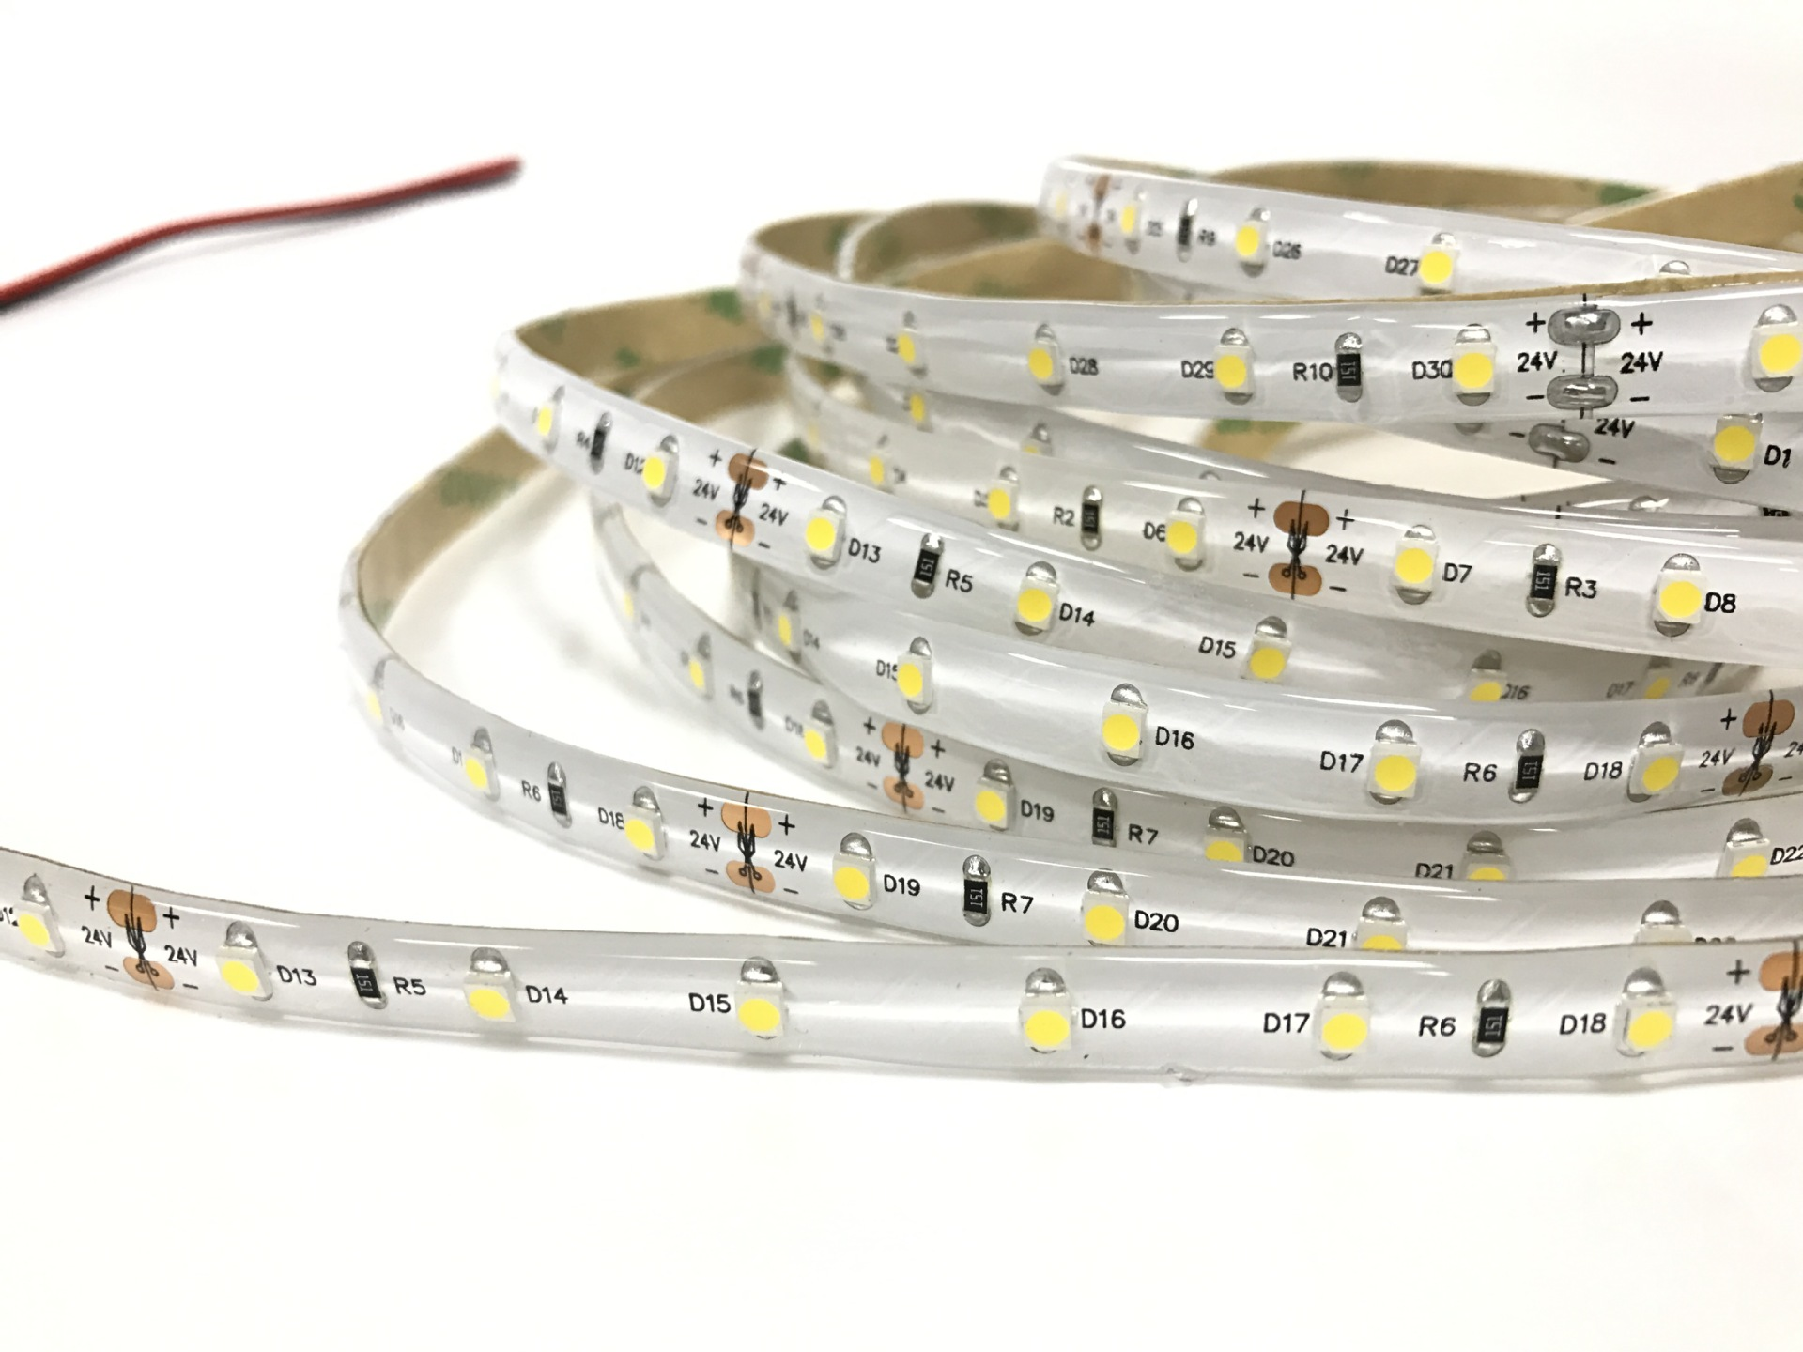
Material selection
Ambient light
MCU
Jetson Nano
Control
Ambient light
Relay
Sensor
Carrier

Slide 4
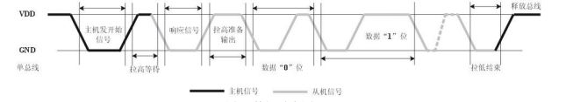
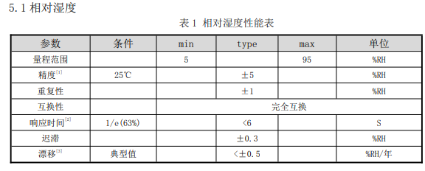
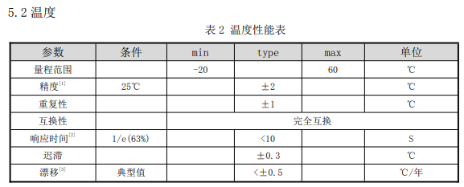
Temperature and humidity sensor
Official parameter
DHT11 Digital Temperature and humidity sensor is a temperature and humidity composite sensor with calibrated digital signal output. It uses dedicated digital module acquisition technology and temperature and humidity sensing technology to ensure high reliability and excellent long-term stability.
Unibus communication
After the user host (MCU) sends a start signal, DHT11 switches from low-power mode to high-speed mode, and when the host start signal ends, DHT11 sends a response signal, sends 40bit data, and triggers a signal acquisition.

Slide 5
Temperature and humidity sensor
The temperature and humidity values read each time are the result of the last measurement. To obtain real-time data, read the temperature and humidity values twice in a row, but do not read the sensor multiple times in a row.
If the power supply part fluctuates, it will affect the temperature. If a switching power supply is used, the temperature will jump.
Capacitive humidity sensor is composed of a plate and a polymer film between it: when the ambient humidity changes, the water content in the polymer film changes, resulting in a change in the permittivity of the capacitor, which leads to a change in the capacitance of the sensor. The current ambient humidity can be calculated by measuring the capacitance value.
As an inertial component, the voltage at both ends of the humidity capacitor cannot change suddenly and follows certain rules. Since the charging characteristics are affected by both the resistance R and the capacitance C in the line, the time constant of the RC circuit is defined as τ=RC. The voltage values at both ends of the capacitor at any time can be determined by formulas [1] and [2].
When charging:
When discharging:
[1]
[2]
Ut is the potential difference between the two ends of the capacitor at any time

Slide 6
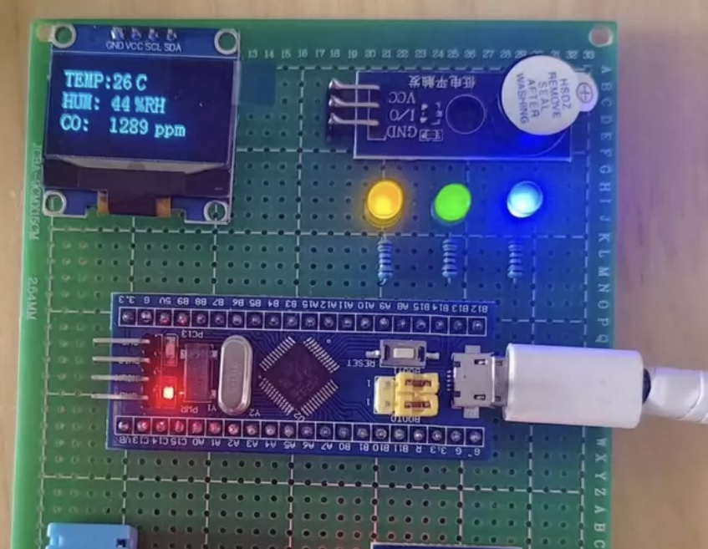
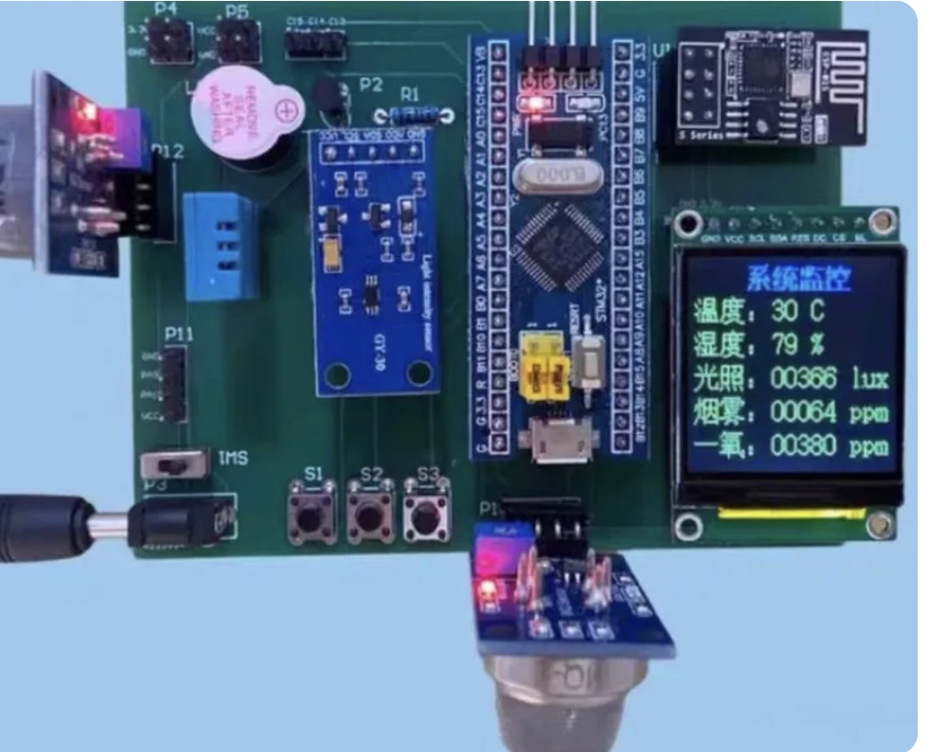
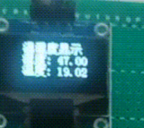
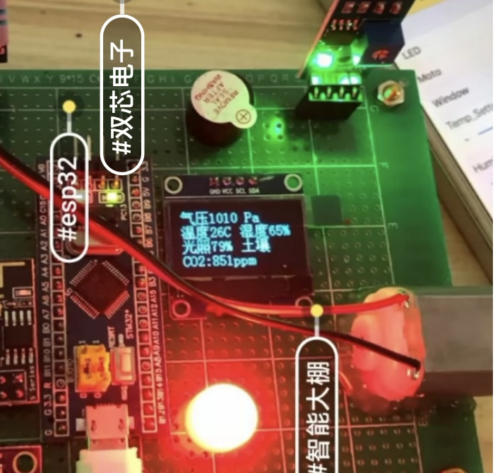
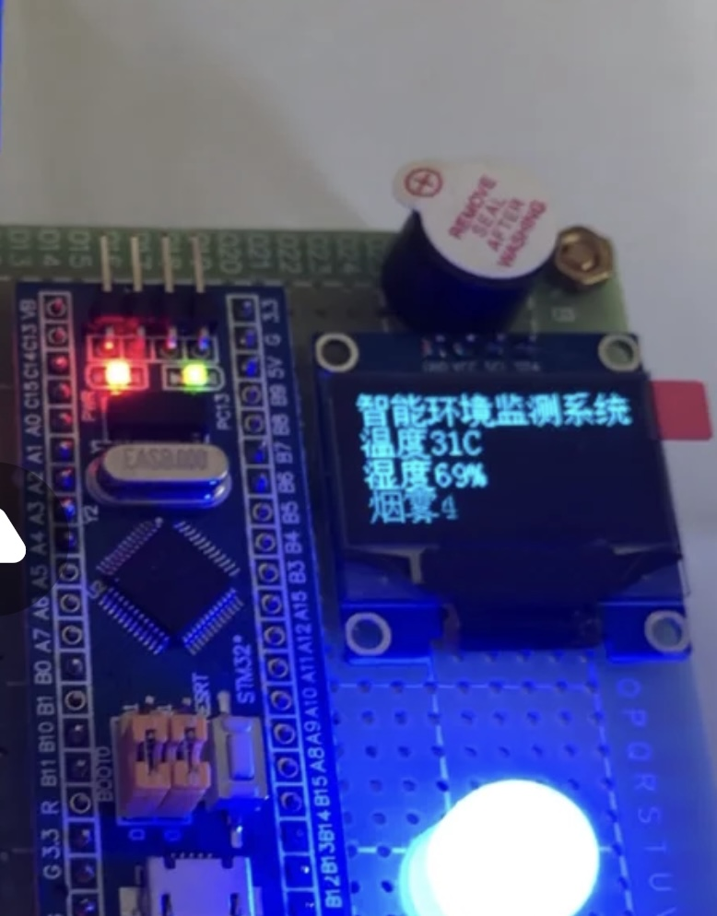
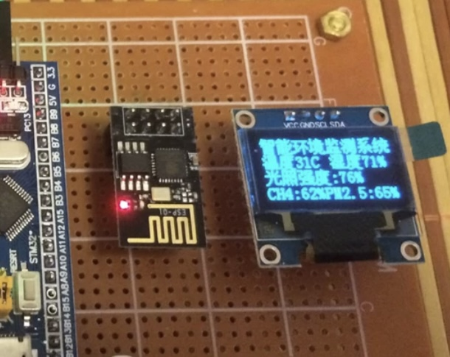
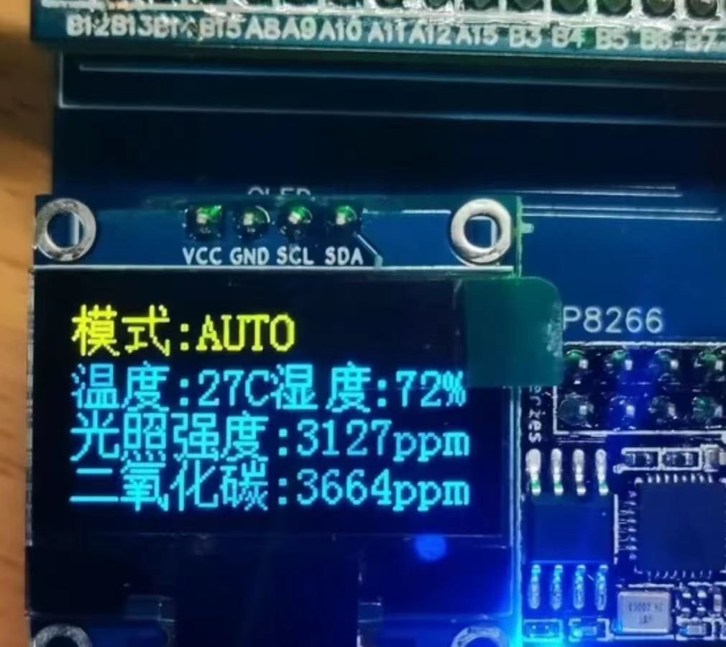
Temperature and humidity sensor

Slide 7
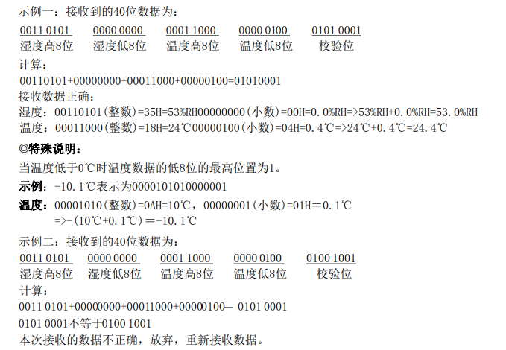
Temperature and humidity sensor

Slide 8
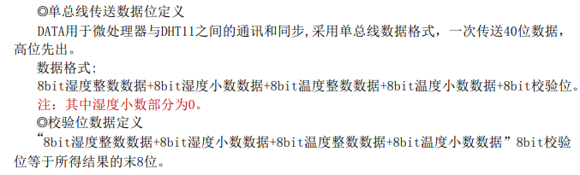
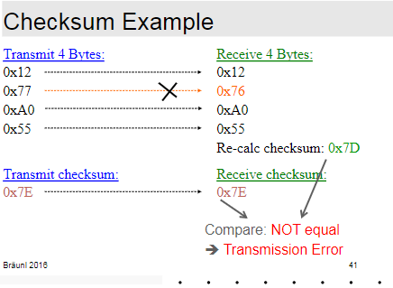
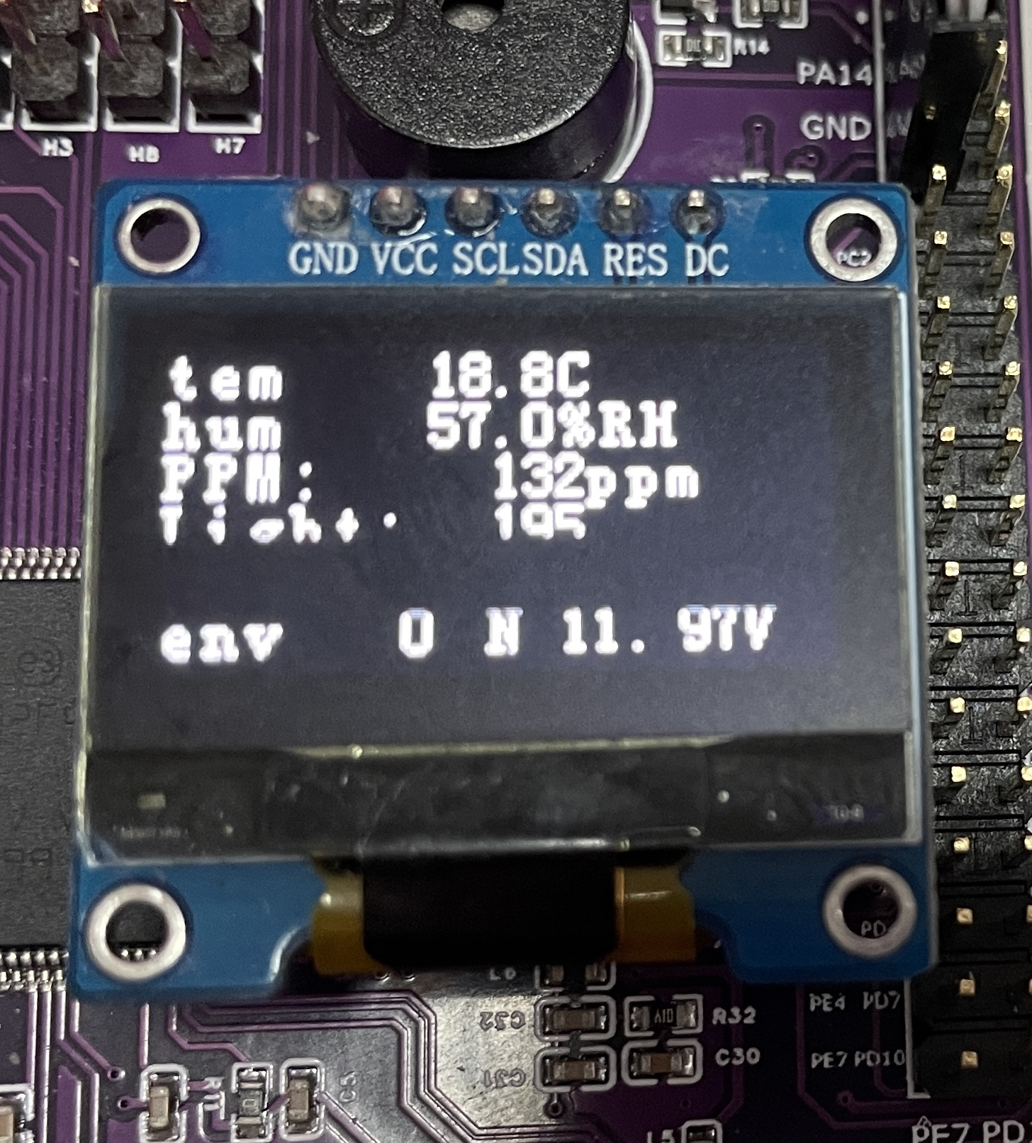
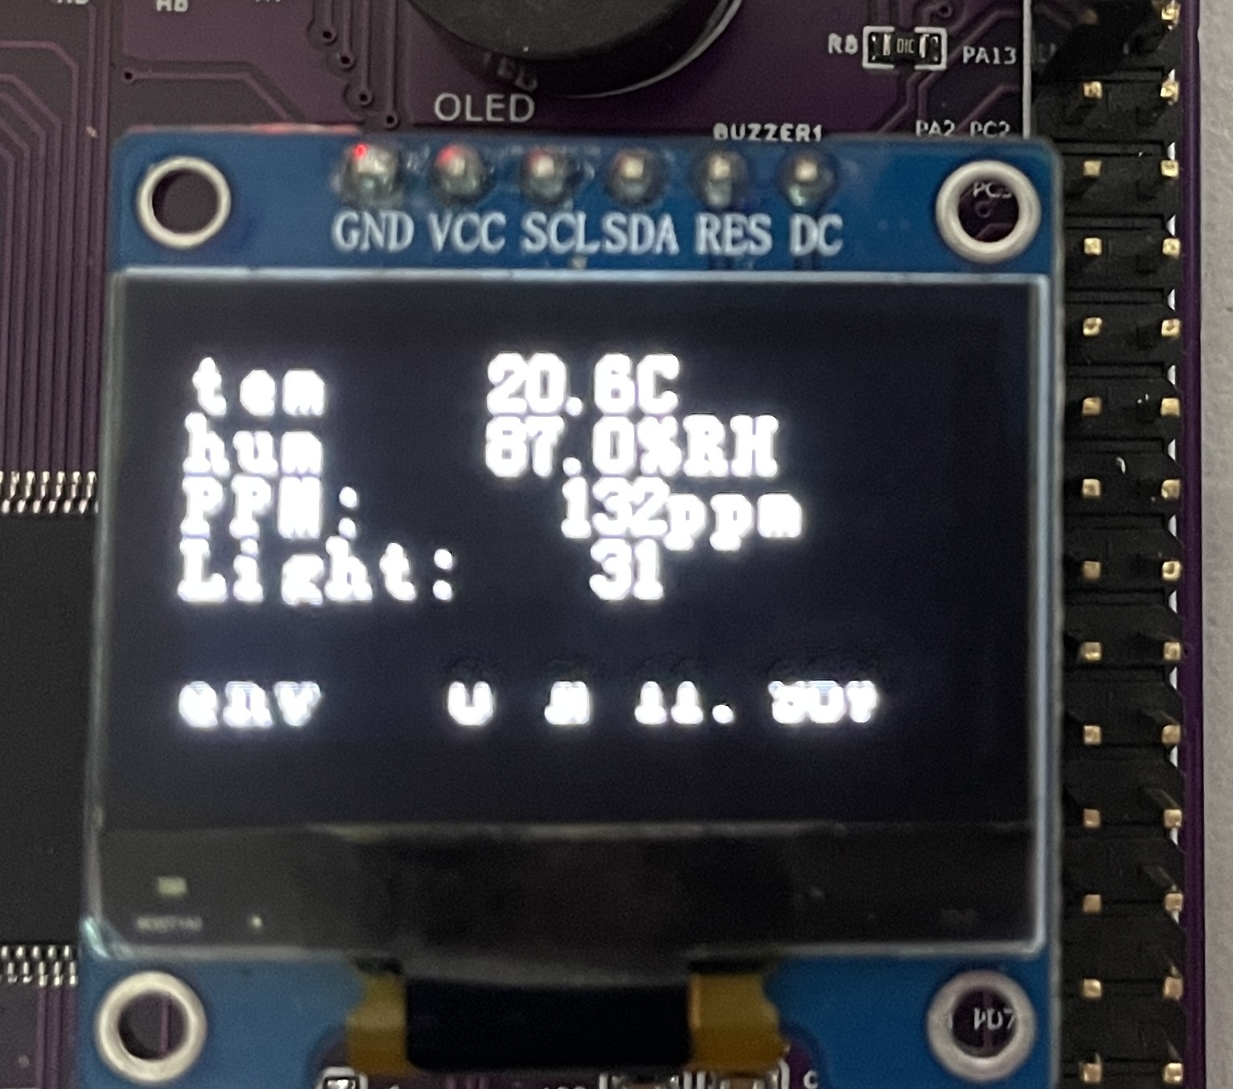
Temperature and humidity sensor

Slide 9
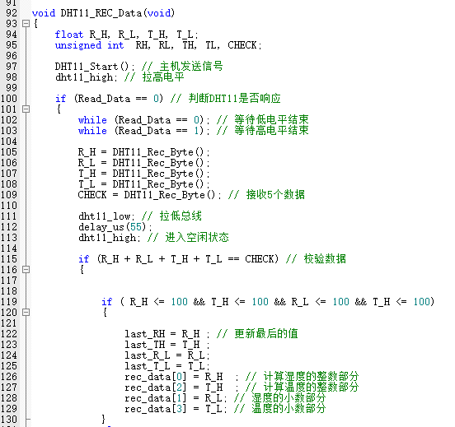
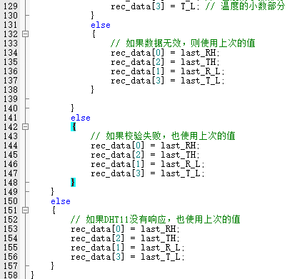
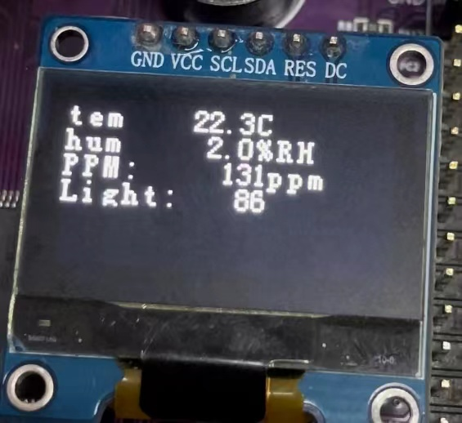
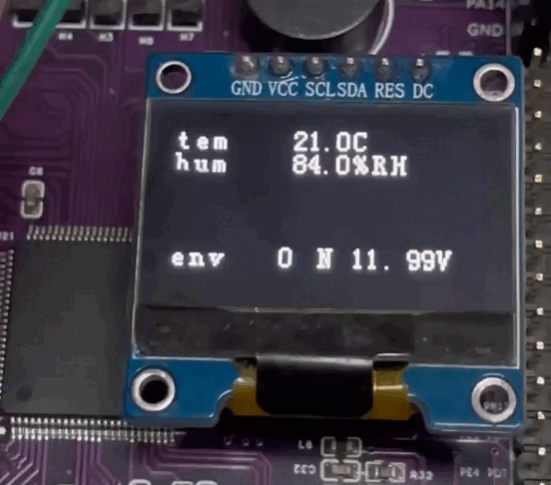
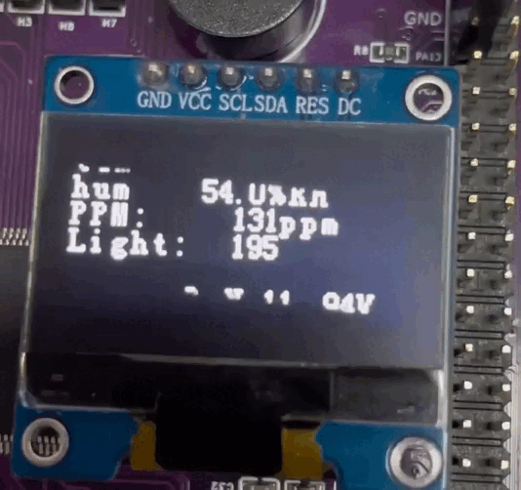
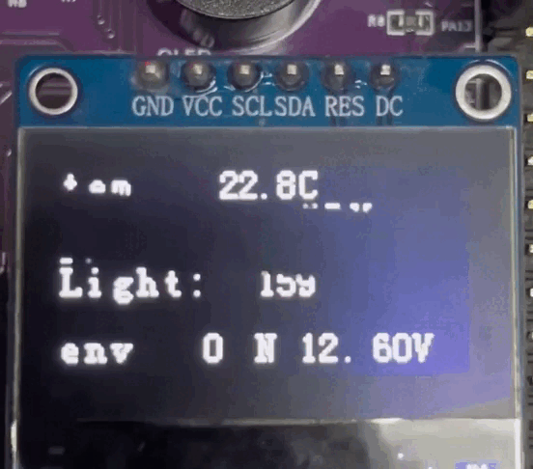
Temperature and humidity sensor

Slide 10
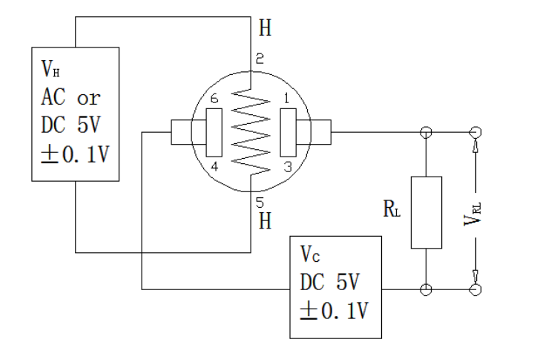
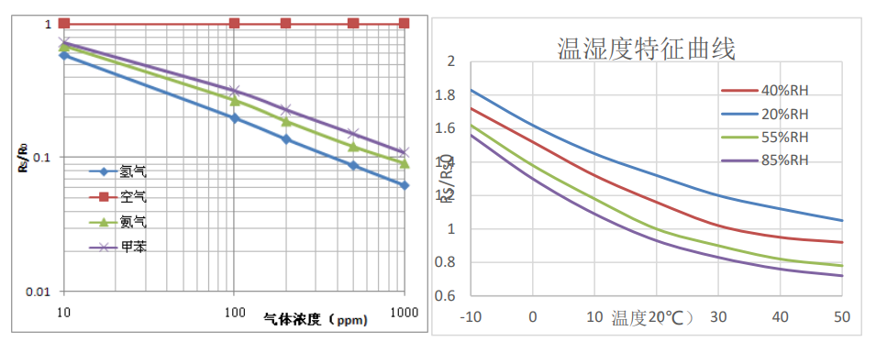
Gas sensor
In the figure, the vertical coordinate is the resistance ratio of the sensor (Rs/R0), and the horizontal coordinate is the gas concentration. Rs indicates the resistance value of the sensor in different concentrations of gas, and R0 indicates the resistance value of the sensor in clean air. All tests in the figure were performed under standard test conditions.
The MQ135 gas sensor is highly sensitive to ammonia, sulfide and benzene vapors, and is also ideal for monitoring smoke and other harmful gases.
Typical temperature and humidity characteristics of the sensor in the graph, the ordinate is the resistance ratio of the sensor (Rs/ RS0). Rs indicates the resistance value of the sensor at 400ppm hydrogen and different temperature/humidity. RS0 indicates the resistance of the sensor at 400ppm hydrogen and 20 ° C /55%RH.

Slide 11
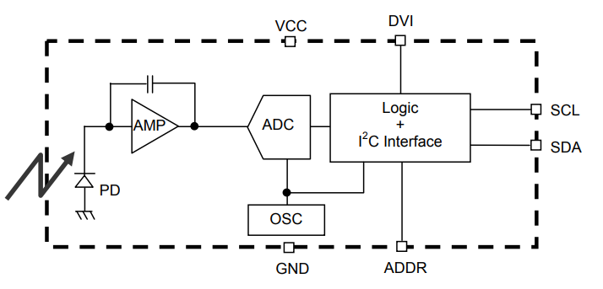
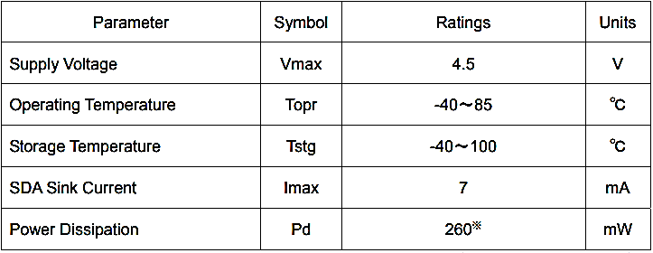

Light intensity sensor
Internal circuit
BH1750FVI is a digital optical intensity sensor integrated circuit for two-wire serial bus interface. This integrated circuit can adjust the brightness of the LCD or keyboard background light based on the light intensity data collected. Its high resolution can be used to detect a large range of light intensity changes.
Photovolta effect
Official parameter
+
-e
P
-e
-
+e
N
+e
sunlight

Slide 12
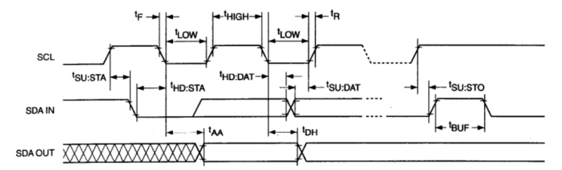
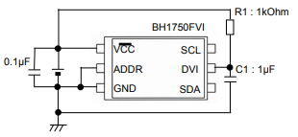
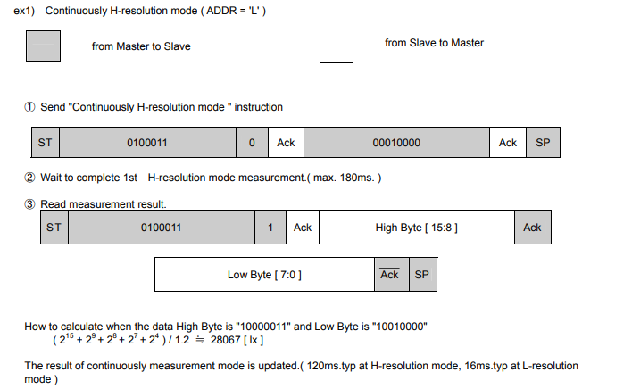
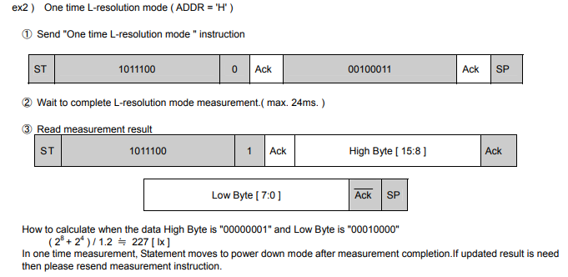
Light intensity sensor

Slide 13
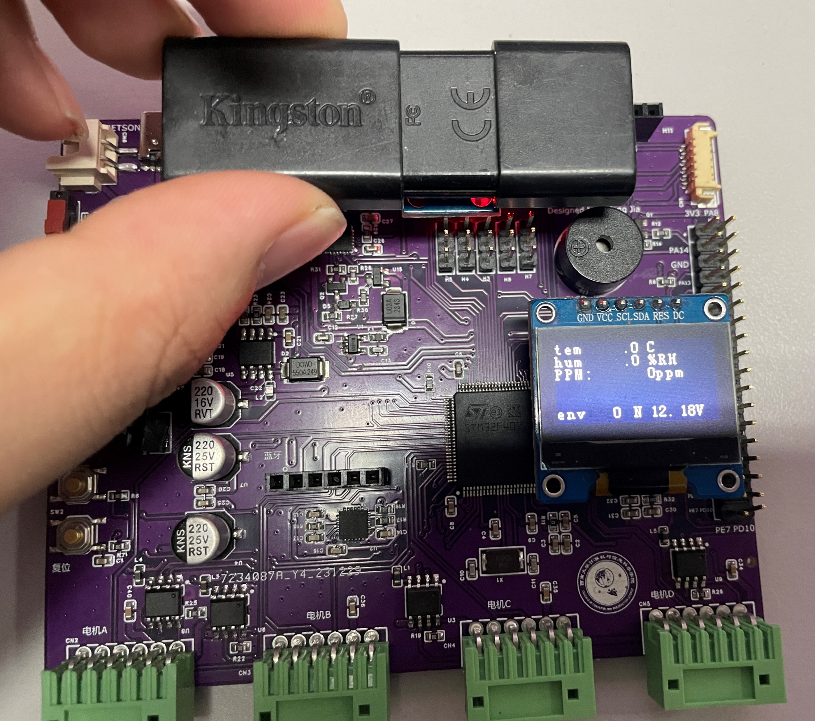
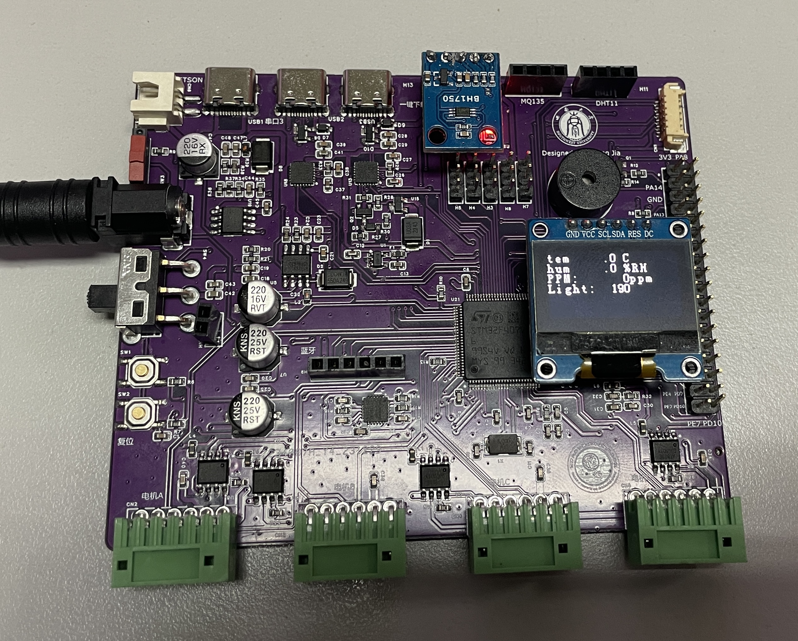
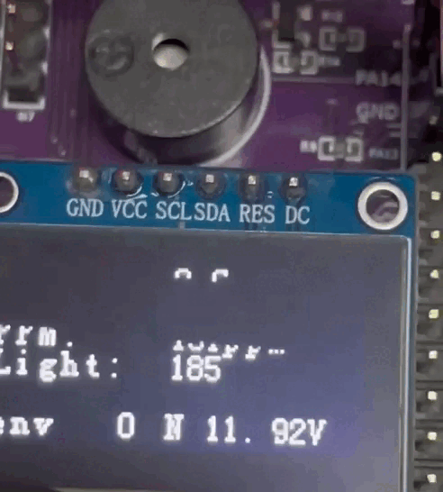
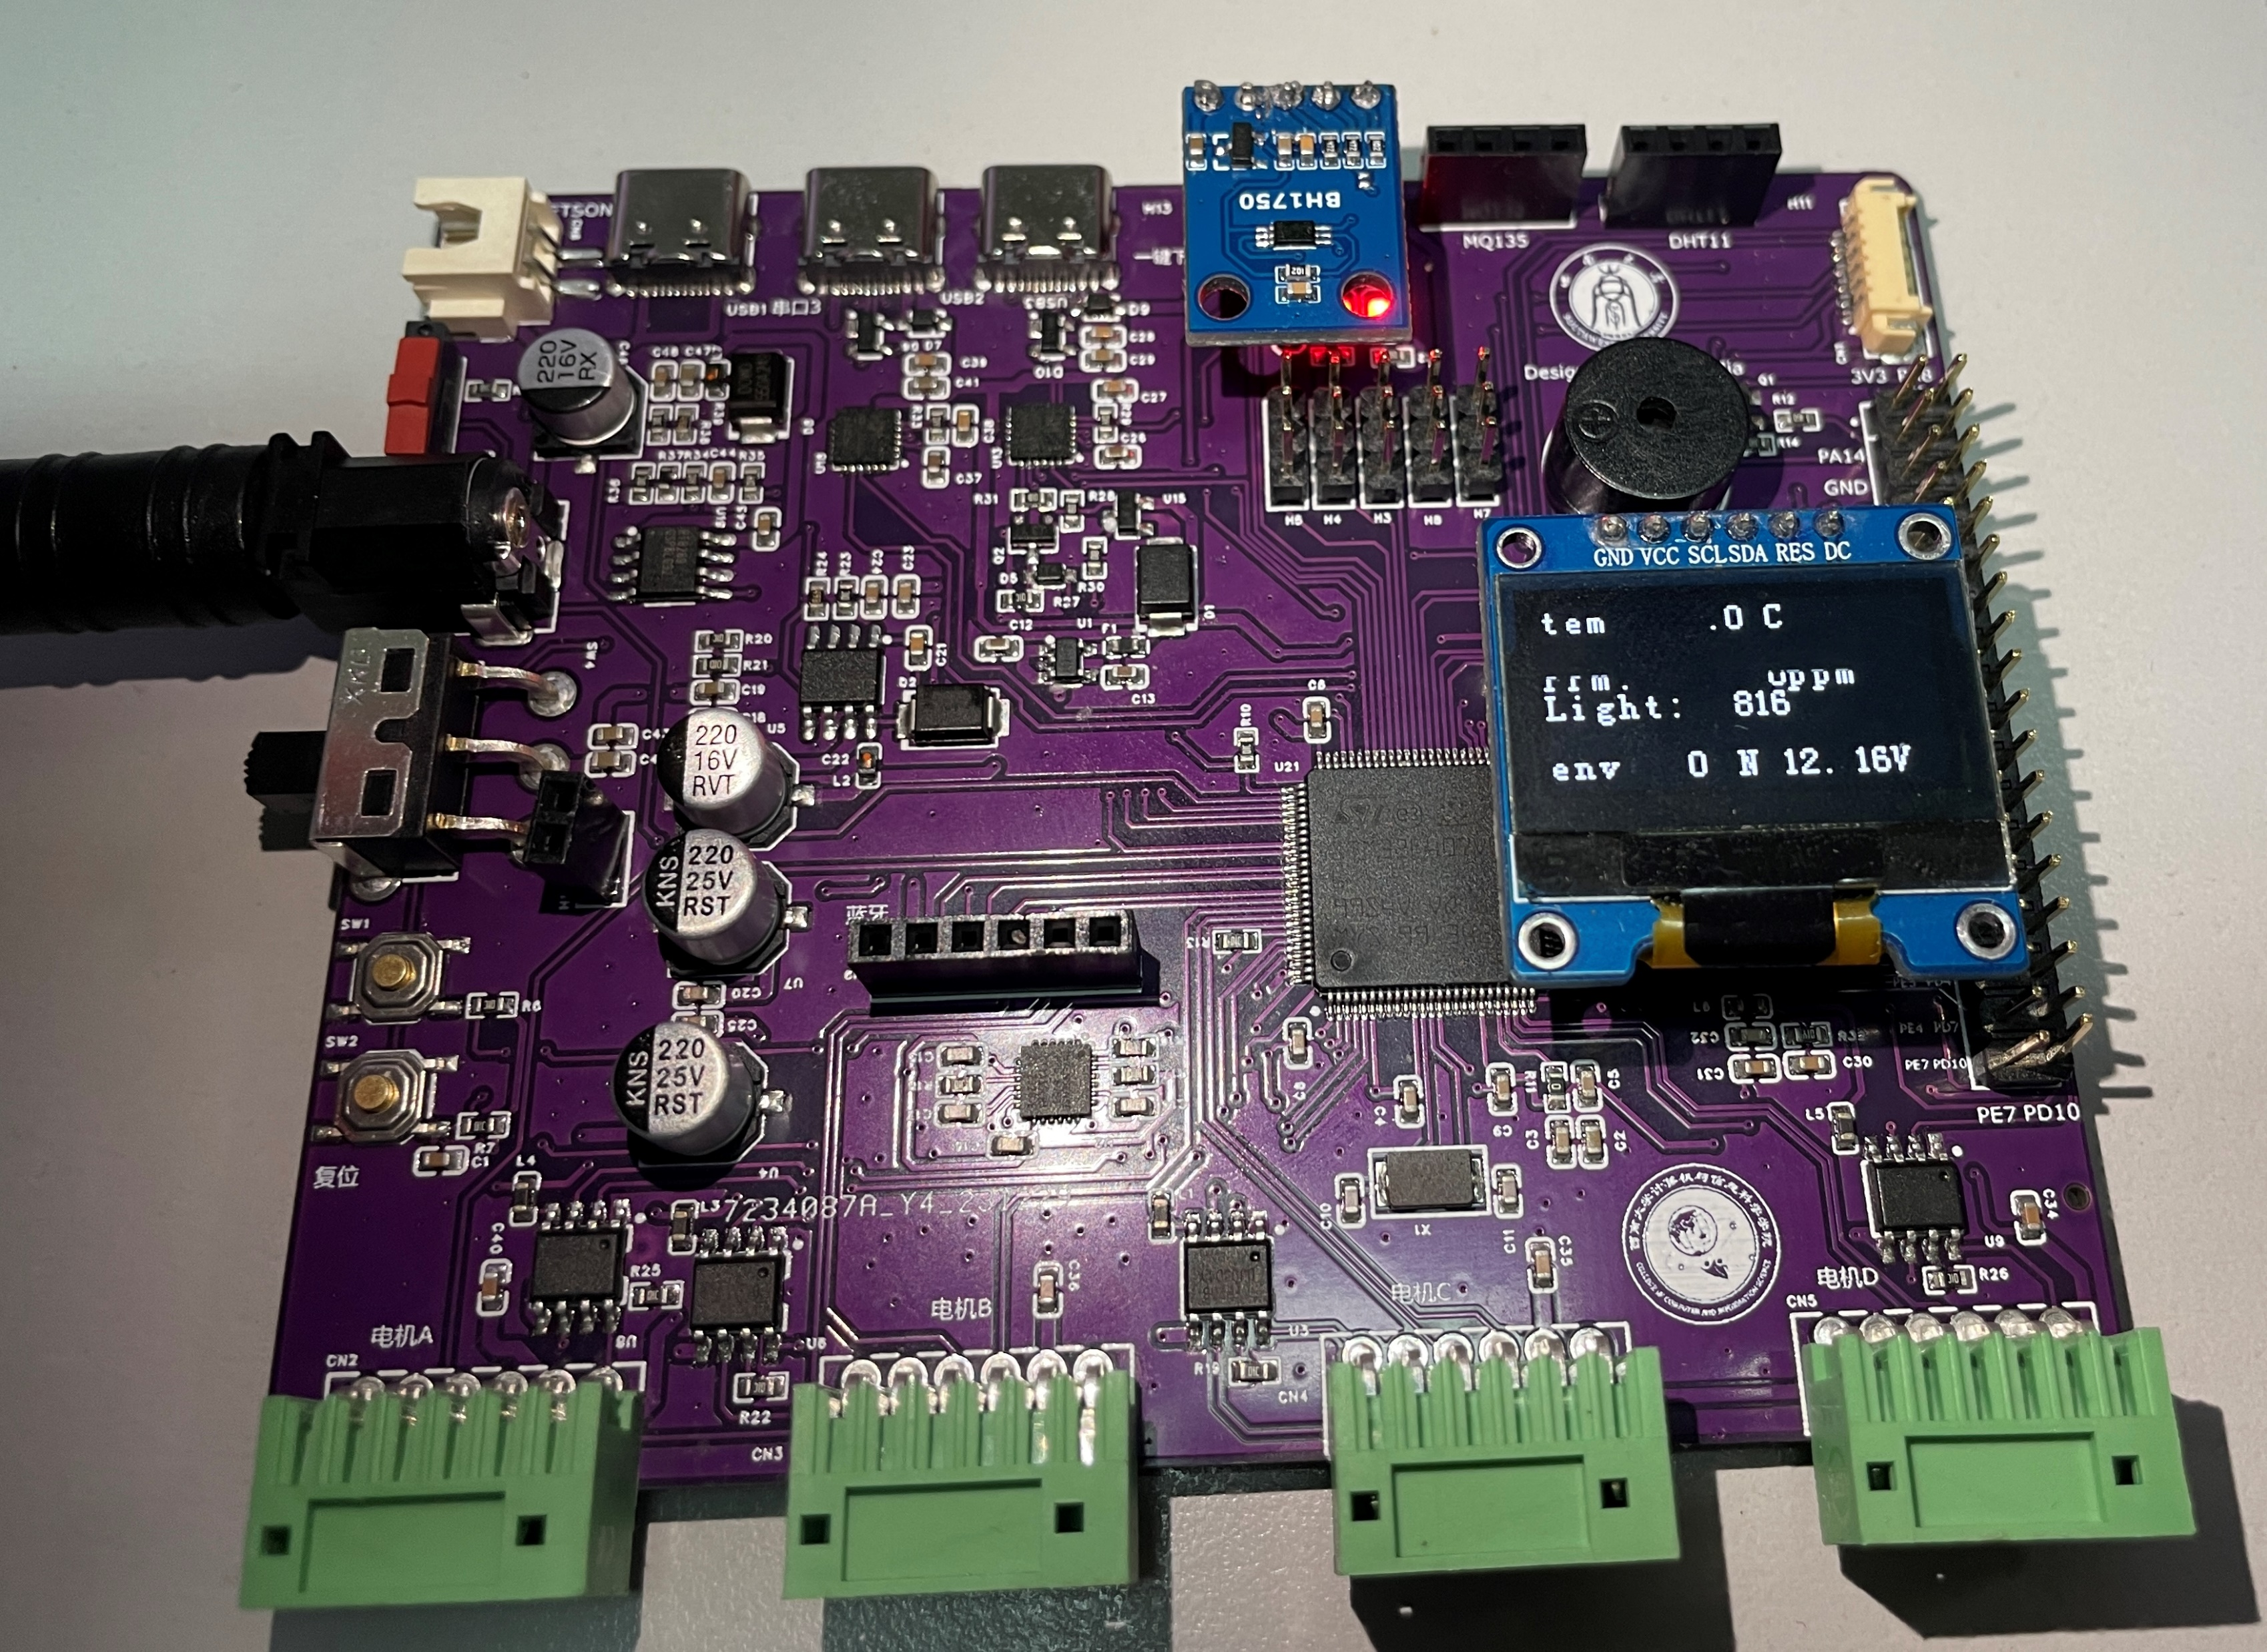
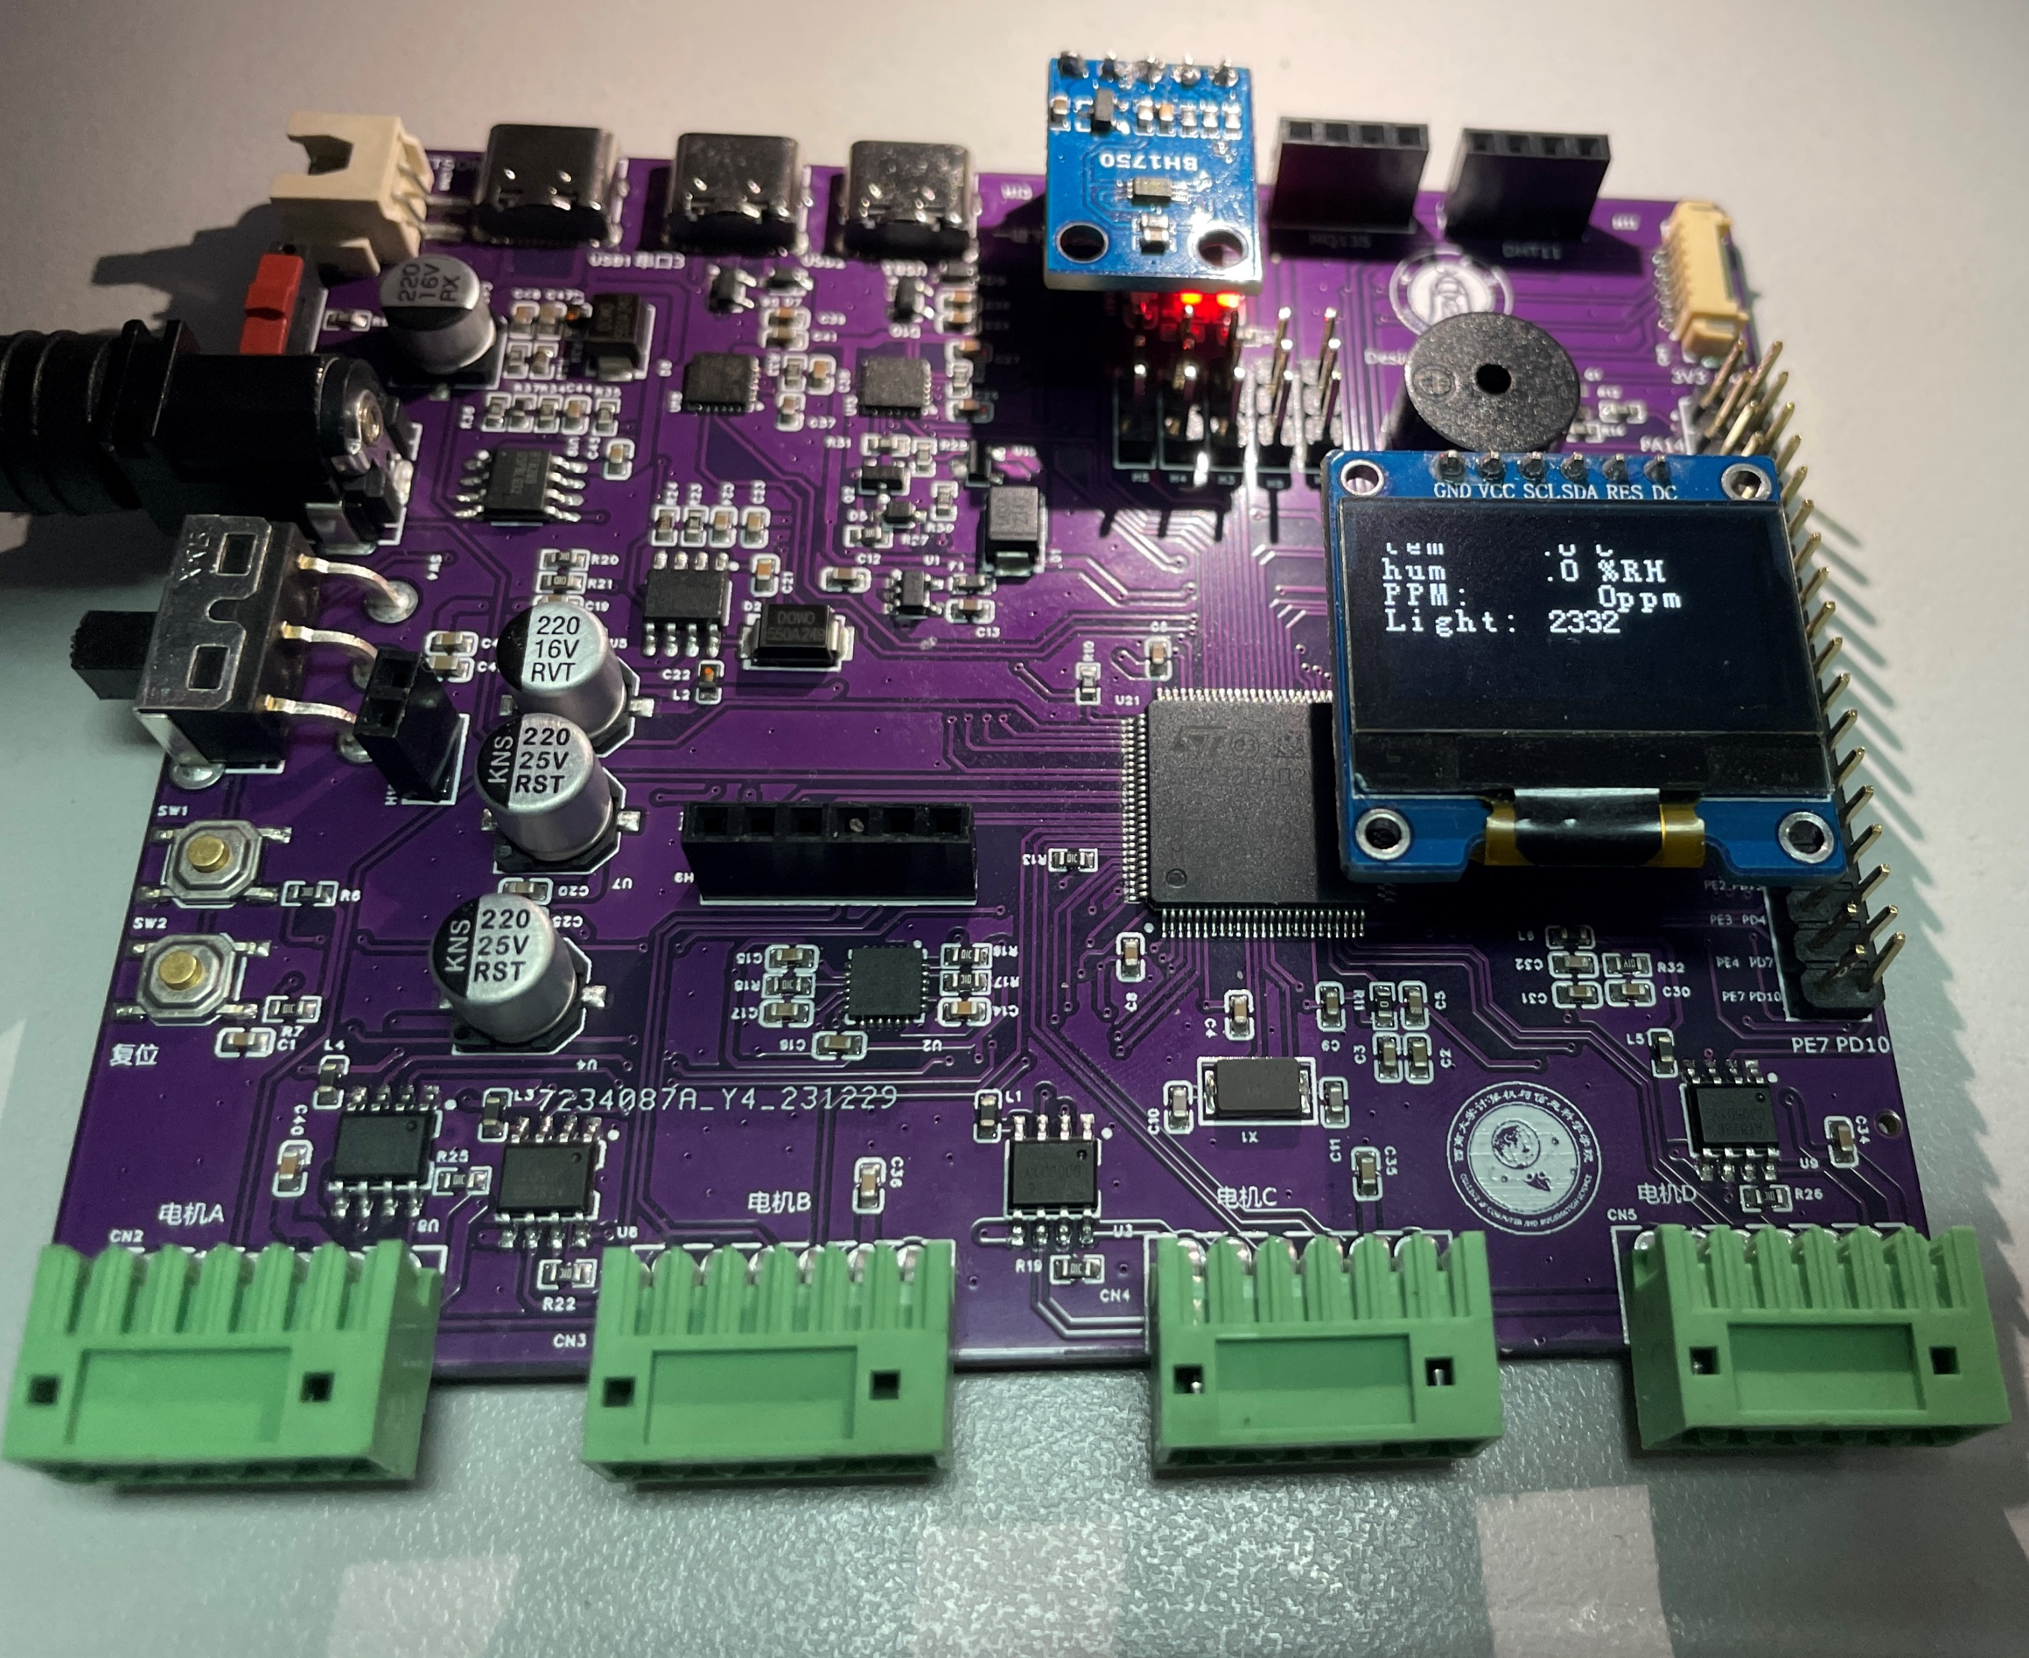
Light intensity sensor

Slide 14
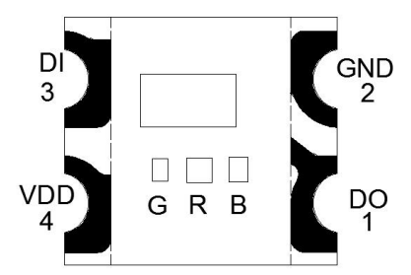
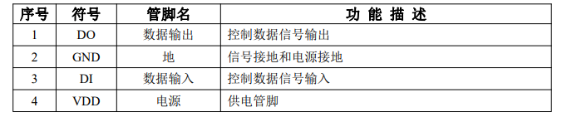
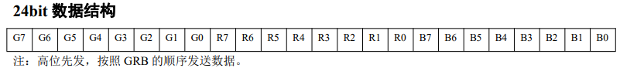
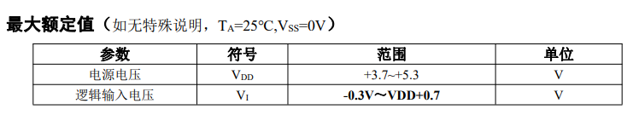
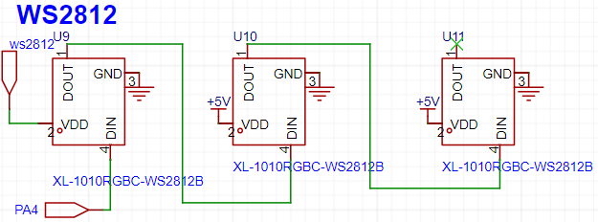
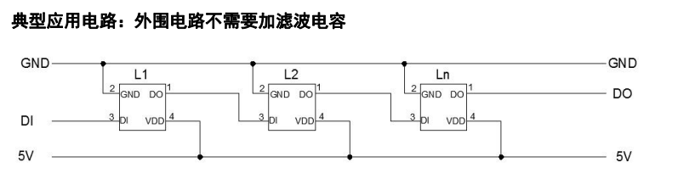
Ambient light

Slide 15
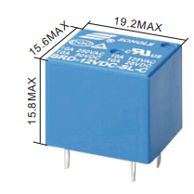
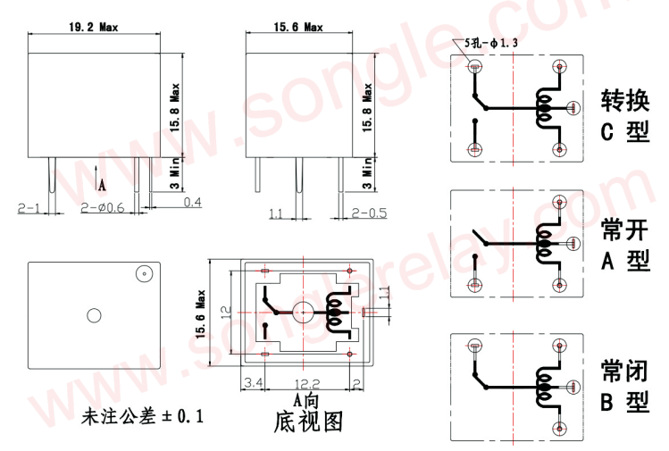
Relay

Slide 16
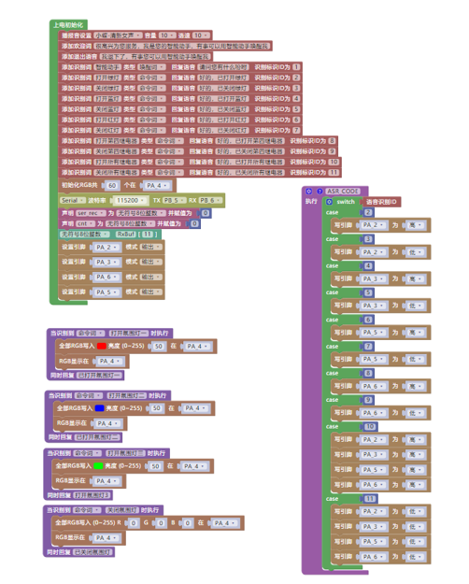



Voice mode

Slide 17






Voice control

Slide 18




Voice interaction
OpenAI
API
Private customization
word check
Content recognition
ChatGPT
Language generation
Language input
Language output
https://openai.com/product
https://platform.openai.com/docs/overview

Slide 19





Voice interaction
More information is in the Attachments folder
https://openai.com/product
https://platform.openai.com/docs/overview

Slide 20


PCB Design
Sensing and control section
Relay section
https://www.jlc.com/

Slide 21


PCB Design
Sensing and control section
https://www.jlc.com/

Slide 22


PCB Design
Relay section
https://www.jlc.com/

Slide 23






PCB Design
Sensing and control
Relay section
https://www.jlc.com/

Slide 24


PCB Design
Top floor
substratum
https://www.jlc.com/

Slide 25


PCB Design
Top floor
substratum
https://www.jlc.com/

Slide 26


PCB Design
https://www.jlc.com/

Slide 27


PCB Design
https://www.jlc.com/

Slide 28


PCB Design
https://www.jlc.com/

Slide 29


PCB Design
https://www.jlc.com/

Slide 30

Human-computer interaction
PyQt qml

